Slide 1
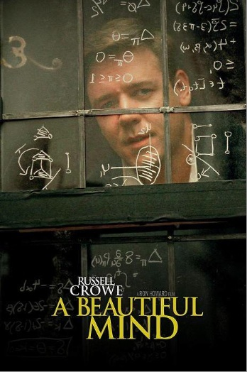
Topic 1: Introduction to game theory
Industrial Organisation / Matěj Bajgar

Slide 2

Raise your hand if...
Notes:
You are from abroad
You have studied IO
You have studied intermediate micro
You are an economics student

Slide 3

What is industrial organisation (IO)?
It studies how firms compete with each other in different markets and industries
It studies markets where perfect competition does not exist (vast majority of markets)
It could be called Economics of Imperfect Competition

Slide 4



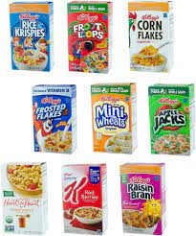


Why called „industrial organisation“?
Nothing to do with (manufacturing) industry
It studies how different industries are organised in terms of
the number and relative size of competitors
the structure of costs
the way firms compete
Group work: How do these industries differ in (a), (b) and (c)
➔ not one-size-fits-all solutions but rather a toolbox to apply in different situations

Slide 5







What is IO good for?
Anti-trust: anti-trust agencies, economic consultanting
Policy: regulation (energy, finance...), R&D support, intellectual property...
Tech firms: auctions, mechanism design, creating and running markets...

Slide 6
Course roadmap
Introduction to game theory
Market power
Anti-competitive strategies
Information
Advertising, marketing and branding
Productivity
R&D, innovation and intellectual property
M&As
Vertical relations
Network effects
Intermediaries and platforms
Auctions

Slide 7
Course materials
Lecture/seminar slides
Published prior to the lecture on SIS
Main textbook
Belleflamme, P., and M. Peitz (2nd ed. 2015) Industrial Organization: Markets and Strategies. Cambridge University Press.
Other textbooks
Pepall, L., D. Richards and G. Norman (5th ed. 2014) Industrial Organization: Contemporary Theory and Empirical Applications. Blackwell Publishing.
Cabral L. M. B. (2000) Introduction to Industrial Organization. MIT Press.
Old exams
An example exam will be added to SIS prior to the mid-term

Slide 8
Communication
Contacting us
matej.bajgar@fsv.cuni.cz
vojtech.misak@fsv.cuni.cz (for inquiries regarding grading)
Consultations
I am available for consultations (in person or via zoom)
Send an email to set an appointment

Slide 9
Grading
Composition of final grade
30% homeworks
20% midterm
50% final
Grades recorded on SIS
Grades ECTS
91-100 A
81-90 B
71-80 C
61-70 D
51-60 E
0-50 F

Slide 10

Home assignments
3 homeworks
Combination of problems, data work and reading summaries
Work out individually (but consult peers if stuck)
Submit in the SIS by midnight of the deadline day
Expected deadlines
Tuesday 12th March
Tuesday 9th April
Tuesday 23th April

Slide 11

Exams
Mid-term (1.5 hours) and Final (3 hours)
Written form
Combination of problems (math) and open text questions
More questions offered than you have to answer
Some answer always better than no answer
Expected dates:
Midterm: Monday 25th March
Final exam (1st date): Monday 13th May

Slide 12
Prerequisities
Microeconomics II
Familiarity with
Graphical and algebraic analysis of economic models
Standard oligopoly models (Cournot, Bertrand, Stackelberg, Hotelling)

Slide 13
Topic 1: Introduction to game theory

Slide 14
Lesson goals
You can explain differences between different types of games
You can tell whether a solution is a Nash equilibrium.
You can identify Nash equilibria in simple games

Slide 15
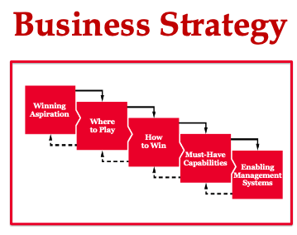

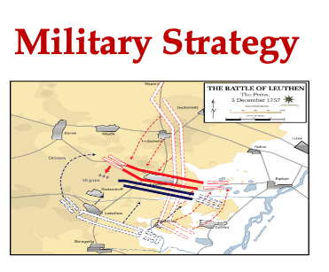
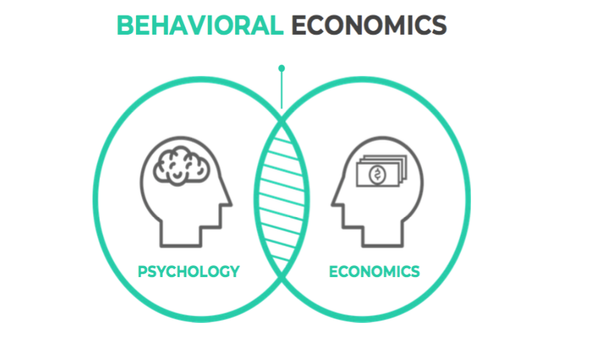
What’s in it for me?
...

Slide 16
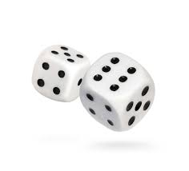
Classroom game
Write on a card a number between 0 and 100 and your name
We calculate the average of all submitted numbers
The winner is the one whose number is closest to a half of that average
i.e. closest to 0.5 * average(number)
Does each player‘s optimal strategy depend on other players‘ strategies?
Which numbers are never optimal? ➔ DOMINATED STRATEGIES
What will happen if we repeat this game many times? ➔ EQUILIBRIUM
What would happen if players guess the average (rather than its half)?
Notes:
write on board you expect 25 in round 1 and 10 in round 2

Slide 17
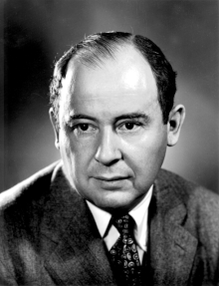
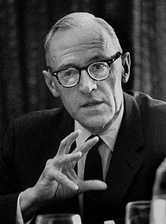
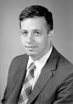
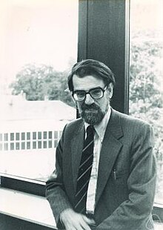
Game theory
Game theory = study of multiperson decision problems
Pioneered in the early 20th century by
John von Neumann
Oscar Morgenstern
Further developed around 1950 by
John Nash
Lloyd Shapley
Nobel prize in economics for game theory
1994 – Nash, Harsanyi, Selten
2006 – Aumann, Schelling
2007 – Hurwicz, Maskin, Myerson
2010 – Shapley, Roth

Slide 18
Topic outline
Classification of games
Normal form games
Components of the game
Dominant strategy equilibrium
Nash equilibrium
Pure vs. mixed strategy equilibrium
Extended form games
Subgame perfect equilibrium
Finite games
Infinitely repeated games

Slide 19
Types of games and game representations
By availability of enforcement of cooperative behaviour
Cooperative – cooperation can be enforced, competition between groups of players, concerned with forming coalitions
E.g. cartel
Non-cooperative – competition between players, cooperation has to be self-enforcing
Most games we will analyse
E.g. prisoners‘ dilemma, Cournot/Bertrange/Stackelberg oligopoly
„Co-operative“ not necessarily a good think in game theory! cartel vs. competition)

Slide 20
Types of games and game representations
By dynamics
Static (or simultaneous) – all players move at the same time
E.g. „guess half of average“ game
Sequential – players move one after another
E.g. chess, Stackelberg oligopoly

Slide 21
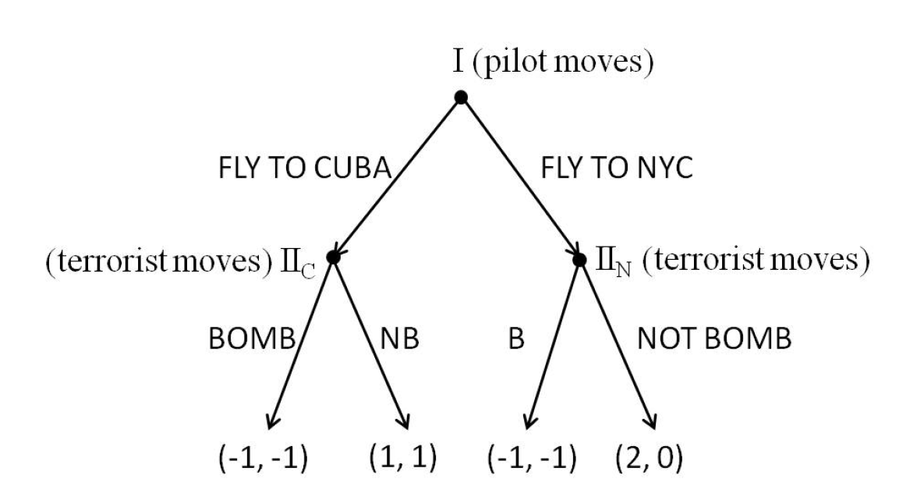
Types of games and game representations
By game representation
Normal form – represented as a matrix,
Typically used to represent static games
Extended form – represented by a decision tree
Typically used to represent sequential games
 | Co-operate | Defect
Co-operate | (-1,-1) | (-10,0)
Defect | (0,-10) | (-6,-6)

Slide 22

Types of games and game representations
By repetition
Single-stage games
E.g. a one-night stand
Finitely repeated games
E.g. dating during a student exchange
Infinitely repeated games
E.g. marriage

Slide 23
Types of games and game representations
By type of action sets
Finite games – each player has a finite number of possible actions
E.g. entry game
Continuous games – e.g. each player‘s strategy is a real number
E.g. cournot competition

Slide 24
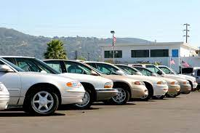
Types of games and game representations
By information availability
Perfect information
E.g. market in new cars
Imperfect/asymmetric information
E.g. market in used cars

Slide 25

Normal-form games
Represented as a matrix
As opposed to game trees in extensive-form games
Often used to represent static games
Example: The Prisoners‘ Dilemma
Prisoner 2
 | Co-operate | Defect
Co-operate | (-1,-1) | (-10,0)
Defect | (0,-10) | (-6,-6)
Prisoner 1
Matrix entries = payoffs
First Entry = Row’s payoff, second entry = Column’s payoff

Slide 26
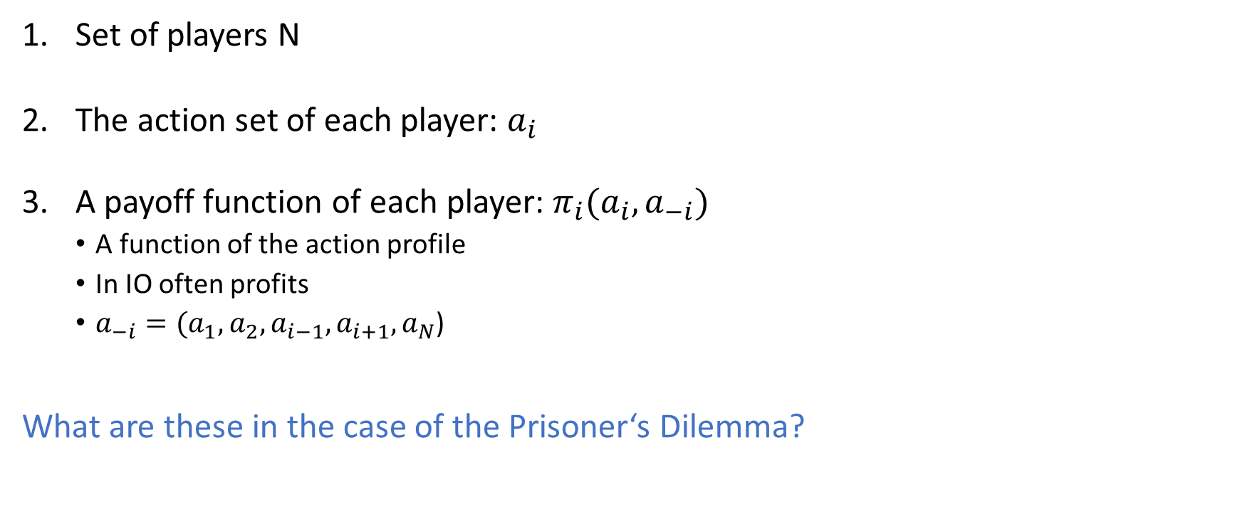
Components of normal-form games
Set of players N
The action set of each player: $a_{i}$
A payoff function of each player: $π_{i}(a_{i},a_{−i})$
A function of the action profile
In IO often profits
$a_{−i}=(a_{1},a_{2},a_{i−1},a_{i+1},a_{N}$)
What are these in the case of the Prisoner‘s Dilemma?

Slide 27
Components of normal-form games
Other concepts
A strategy of a player
The player‘s complete plan of actions taken that each step
In a simple simultaneous game, strategy = action
The action profile of all players‘ actions: a = a₁....a_{N}
A strategy profile = all players‘ chosen stategies

Slide 28

Dominance
Strategy $a_{−i}$ dominates strategy $a_{i}^{′}$if it always leads to at least as high payoff
$π_{i}(a_{i},a_{−i})≥π_{i}(a_{i}^{′},a_{−i})$ for all $a_{−i}$
A strategy is a dominant strategy of player i if it dominates all other strategies
$π_{i}(a_{i},a_{−i})≥π_{i}(a_{i}^{′},a_{−i})$for all $a_{−i}$and $a_{i}^{′}$
Strategies can be strictly (>) or weakly (≥) dominant

Slide 29
Dominance
Is there a dominant strategy in the Prisoners‘ Dilemma?
Prisoner 2
 | Co-operate | Defect
Co-operate | (-1,-1) | (-10,0)
Defect | (0,-10) | (-6,-6)
Prisoner 1

Slide 30
Dominance
Is there a dominant strategy in the Prisoners‘ Dilemma?
Prisoner 1 always does better by defecting (no matter what prisoner 2 does)
Prisoner 2
 | Co-operate | Defect
Co-operate | (-1,-1) | (-10,0)
Defect | (0,-10) | (-6,-6)
Prisoner 1

Slide 31
Dominance
Is there a dominant strategy in the Prisoners‘ Dilemma?
Prisoner 1 always does better by defecting (no matter what prisoner 2 does)
Prisoner 2 always does better by defecting (no matter what prisoner 1 does)
Prisoner 2
 | Co-operate | Defect
Co-operate | (-1,-1) | (-10,0)
Defect | (0,-10) | (-6,-6)
Prisoner 1

Slide 32
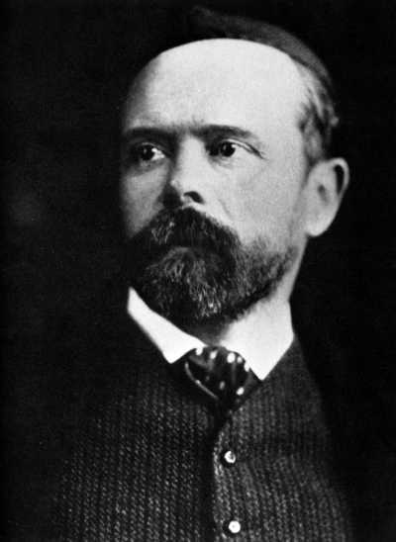
Equilibrium
To understand what we can expect to happen in a game, we need to identify the equilibrium.
But what equilibrium?
In competitive markets, we can look for the Walrasian equilibrium: For a given price, demanded quantity equals the supplied quantity
But how to define equilibrium in strategic interactions?
One option is equilibrium in dominant strategies: Each player is choosing their dominant strategy

Slide 33
Equilibrium in the Prisoners‘ Dilemma
Prisoner 1 always does better by defecting (no matter what prisoner 2 does)
Prisoner 2 always does better by defecting (no matter what prisoner 1 does)
For both players, defecting is a strongly dominant strategy
➔ Defect-defect is the equilibrium in dominant strategies
Prisoner 2
 | Co-operate | Defect
Co-operate | (-1,-1) | (-10,0)
Defect | (0,-10) | (-6,-6)
Prisoner 1

Slide 34


Nash equilibrium
Example: The Battle of Cultures
She: Finnish
He: Czech
 | Travel with friends | Travel w/o friends
Travel with friends | (2,1) | (0,0)
Travel w/o friends | (0,0) | (1,2)
What is the Nash equilibrium to this game?
What Matej wants depends on what his wife wants ➔ no strictly dominant strategies
➔ Need for a different equilibrium concept

Slide 35
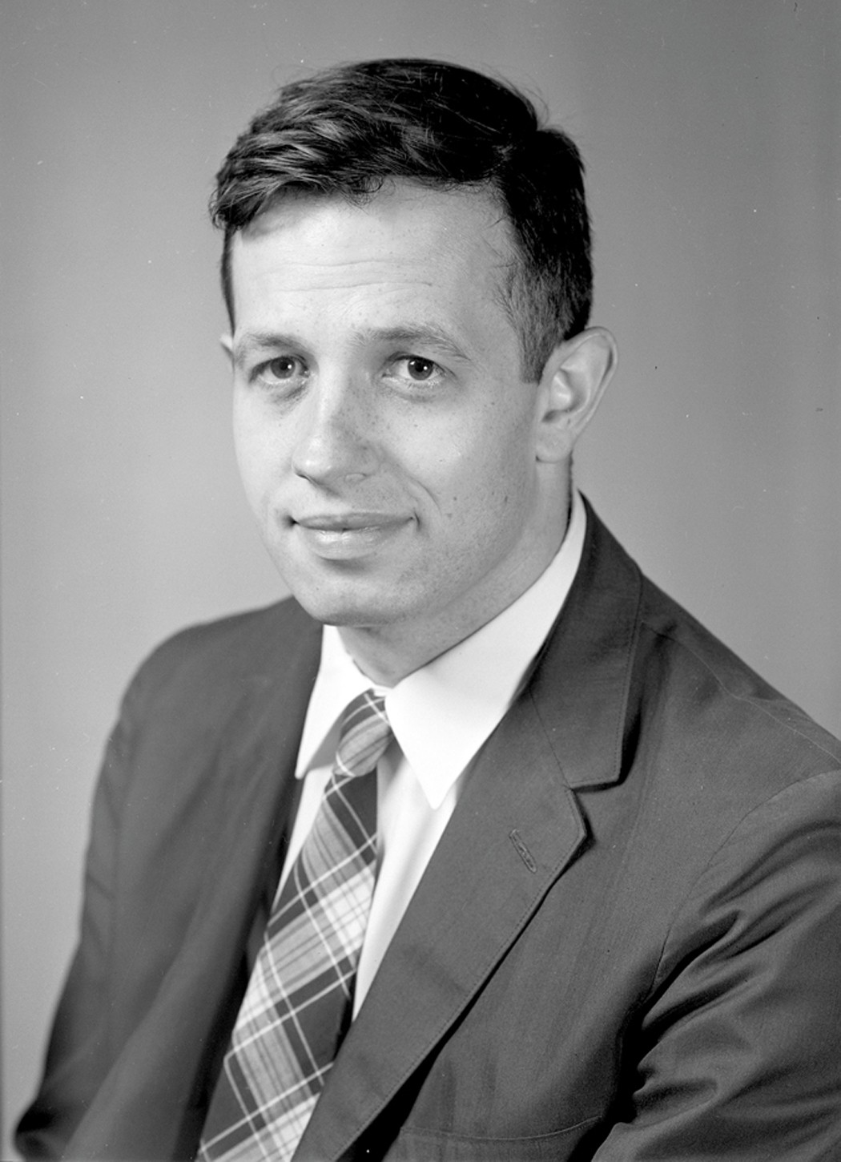
Nash equilibrium
Nash equilibrium (in pure strategies) if: No player has an incentive to change strategy given other player‘s strategies
Notes
Only consider unilateral deviations from the strategy profile
Equilibrium in dominant strategies is a Nash equilibrium but the opposite is not necessarily true
Player‘s best response = the preferred strategy given what others are doing ➔ Nash equilibrium if all players are playing their best response
In the classroom game, was everyone picking 0 a Nash equilibrium?
Notes:
A strategy may be optimal given what others are doing right now but not optimal also given all other possible actions by others

Slide 36
Nash equilibrium in the Prisoner‘s Dilemma
Prisoner 2
 | Co-operate | Defect
Co-operate | (-1,-1) | (-10,0)
Defect | (0,-10) | (-6,-6)
Prisoner 1

Slide 37
Nash equilibrium in the Prisoner‘s Dilemma
Prisoner 2
 | Co-operate | Defect
Co-operate | (-1,-1) | (-10,0)
Defect | (0,-10) | (-6,-6)
Prisoner 1
Dominant strategy equilibrium ➔ Nash equilibrium

Slide 38
Nash equilibrium in the Battle of Cultures
She: Finnish
He: Czech
 | Travel with friends | Travel w/o friends
Travel with friends | (2,1) | (0,0)
Travel w/o friends | (0,0) | (1,2)

Slide 39
Nash equilibrium in the Battle of Cultures
She: Finnish
He: Czech
 | Travel with friends | Travel w/o friends
Travel with friends | (2,1) | (0,0)
Travel w/o friends | (0,0) | (1,2)
2 Nash equilibria
What if multiple Nash equilibria?
One might stand-out because it is Pareto-dominant
One might stand-out because it acts as a focal point
History may matter

Slide 40
Pure- and mixed-strategy equilibrium
Example: Game of pennies
Odd
Even
 | Head | Tail
Head | (1,-1) | (-1,1)
Tail | (-1,1) | (1,-1)

Slide 41
Pure- and mixed-strategy equilibrium
Example: Game of pennies
Odd
Even
 | Head | Tail
Head | (1,-1) | (-1,1)
Tail | (-1,1) | (1,-1)
Even prefers to do what the odd is doing
Odd prefers to do the opposite of what Even is doing

Slide 42
Pure- and mixed-strategy equilibrium
Example: Game of pennies
Odd
Even
 | Head | Tail
Head | (1,-1) | (-1,1)
Tail | (-1,1) | (1,-1)
No equilibrium in strictly dominant strategies
But also no Nash equilibrium...
... or more precisely no „pure strategy Nash equilibrium“
Equilibrium in pure strategies: each player is playing their best response
But there can be a mixed strategy equilibrium
Equilibrium in mixed strategies: A mix of different pure strategies, each played with a certain probability

Slide 43
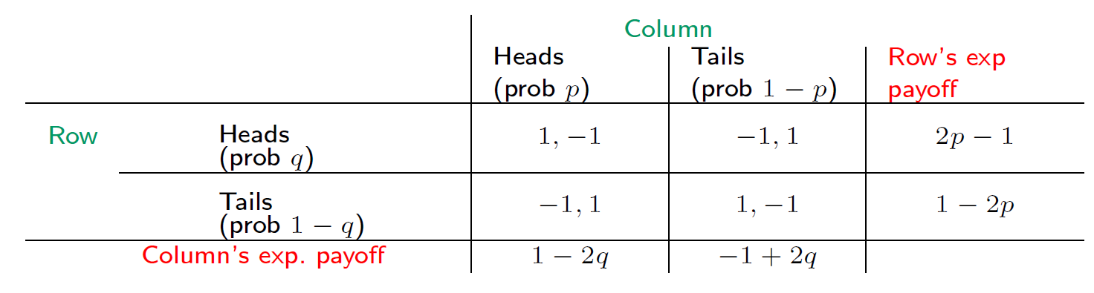
Pure- and mixed-strategy equilibrium
Example: Game of pennies
Suppose
p = probability Odd plays Head and 1-p = probability they play Tail
q = probability Even plays Head and 1-q = probability they play Tail
If 2p – 1 > 0, Even is better off playing only Head
If 2p – 1 < 0, Even is better off playing only Tail
➔ Even randomises only if p = 1/2, and Odd randomises only if q = 1/2
➔ Nash equilibrium in mixed strategies where both players play Head 50% of the time
NOTE: NE in pure strategies is a special case of NE in mixed strategies

Slide 44
Existence of Nash equilibrium
Every game in which each player has a finite number of pure strategies has at least one equilibrium (possibly in mixed strategies).

Slide 45
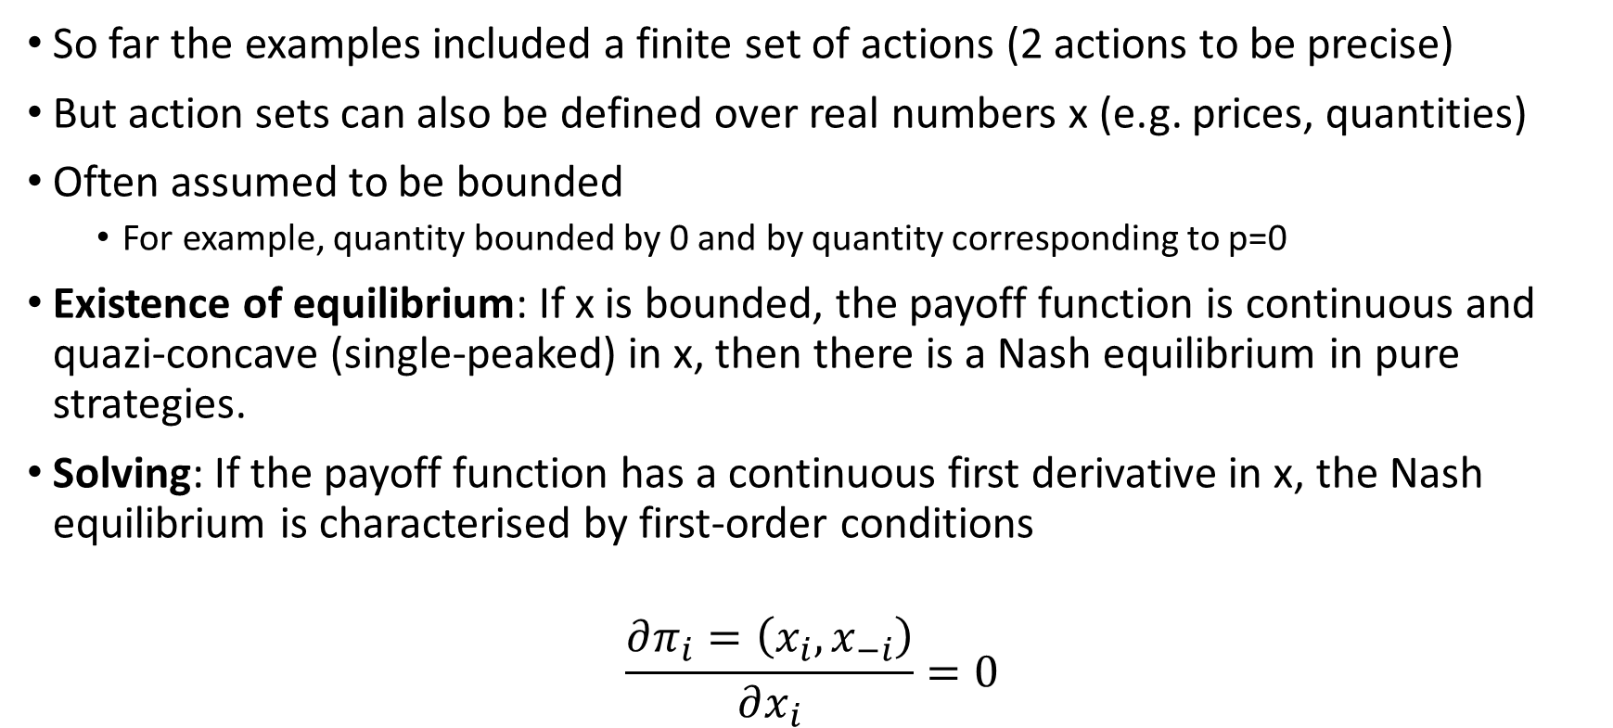
Continuous games
So far the examples included a finite set of actions (2 actions to be precise)
But action sets can also be defined over real numbers x (e.g. prices, quantities)
Often assumed to be bounded
For example, quantity bounded by 0 and by quantity corresponding to p=0
Existence of equilibrium: If x is bounded, the payoff function is continuous and quazi-concave (single-peaked) in x, then there is a Nash equilibrium in pure strategies.
Solving: If the payoff function has a continuous first derivative in x, the Nash equilibrium is characterised by first-order conditions
$$\frac{∂π_{i}=\left(x_{i},x_{−i}\right)}{∂x_{i}}=0$$

Slide 46
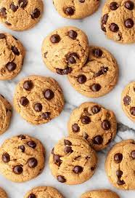
Classroom game
“Hamoun” game
2 players
22 mini-cookies
At each turn, you can eat 1, 2 or 3 cookies
Discussion
Can either player ensure a win (independent of what the other player does)?
How do you arrive at the answer?

Slide 47
Extended-form games
Represented by a game tree (rather than a payoff matrix)
Often used to represent sequential games
Components
Set of players
Game tree including nodes (starting nodes, other decision nodes, terminal nodes) and branches linking nodes
For each node, the name of a player entitled to choose an action
For each player and relevant node, an action set
Payoff of each player at each terminal node
more information-heavy than normal-form game
A strategy of player i = one action for each relevant decision node

Slide 48
Extended-form games
Example: The terrorist-pilot game
Notes:
Terrorist wants to fly to Cuba, says that if they don’t fly to Cuba, he will explode a bomb

Slide 49
Extended-form games
Subgame = a branch of the tree
Subgame perfect equilibrium = a profile of strategies is subgame-perfect equilibrium (SPE) if it induces a Nash equilibrium in all subgames
If sequential and finite number of periods ➔ solve by backward induction

Slide 50
Extended-form games
Example: The terrorist-pilot game
Notes:
Sequential ➔ backward induction
Stage 2:
If pilot flies to Cuba, terrorist is happy and does not explode the bomb
If pilot flies to NYC, terrorist prefers not to die and does not explode the bomb
Stage 1: Since either way no explosion, pilot prefers to fly to NYC
So the subgame-perfect equilibrium is NYC+no explosion (assuming the terrorist is rational)

Slide 51
Finite repeated games
Example: The centipede game (Rosenthal, 1981)
Two players: Eliška and Markéta
100 rounds
Eliška has two piles of coins in front of her: one pile contains 4 coins and the other pile contains 1 coin
Eliška can either "take" the larger pile of coins and give the smaller pile to the other player or "push" both piles across the table to Markéta
Each time the piles of coins pass across the table, the quantity of coins in each pile doubles.
For example, assume that Eliška chooses to "push" the piles on her first move, handing the piles of 1 and 4 coins over to Markéta, doubling them to 2 and 8. Markéta could now use his first move to either "take" the pile of 8 coins and give 2 coins to Eliška, or she can "push" the two piles back across the table again to Eliška, again increasing the size of the piles to 4 and 16 coins
The game continues for 100 rounds or until a player decides to end the game by pocketing a pile of coins.
What do you think is the Subgame perfect equilibrium here?

Slide 52
Finite repeated games
Example: The centipede game (Rosenthal, 1981)
Finite repeated games can be solved by backward induction
In the last round, the Markéta has an incentive to defect
Knowing that, Eliška has incentive to defect in the second to last round
Knowing that, Markéta....
➔ Eliška defects in the first round
Clearly not pareto efficient

Slide 53
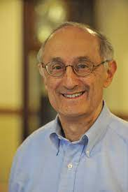
Finite and infinitely repeated games
Example: Repeated prisoners‘ dilemma
With a finite number of rounds:
Backward induction ➔ similar to a single round
With an infinite number of rounds:
Cooperation possible
Strategies may involve punishment for defecting
Axelrod‘s tournament
In 1980, Robert Axelrod organised a tournament of strategies for the prisoners‘ dilemma
Examples of strategies:
Always defect (what game theory implies) – safe but misses on large payoffs
Always cooperate – good against itself but vulnerable to exploitation
Random
WINNER: Tit-for-tat
Cooperates on the first move and then does whatever their opponent has done
Variants: Tit-for-two-tats, Two-tits-for-tat

Slide 54

Review task (it’s movie time!)
https://econ.video/2017/08/23/a-beautiful-mind-ignoring-the-blonde/#more-536
Notes:
Extended form: represented by a game tree, rather than a payoff matrix
What does a standard game in include?
Set of players
Game tree including nodes (starting nodes, other decision nodes, terminal nodes) and branches linking nodes
For each node, the name of a player entitled to choose an action
For each player and relevant node, an action set
Payoff of each player at each terminal node
➔ more information heavy than normal-form game
Complete strategy of actions for player i
one action for each relevant decision node
Subgame
a decision node along with all subsequent nodes (a branch or subbranch of the tree)
strict subgame is a subgame that is not the original game (if there are N subgames, there are N-1 strict subgames)
Subgame perfect equilibrium
a profile of strategies is subgame-perfect equilibrium (SPE) if it induces a Nash equilibrium in all subgames
If sequential and finite number of periods, then can be solved by backward induction (not necessarily the case if at some nodes players decide simultaneously)
The terrorist-pilot game
Terrorist wants to fly to Cuba, says that if they don’t fly to Cuba, he will explode a bomb
Sequential ➔ backward induction
Stage 2:
If pilot flies to Cuba, terrorist is happy and does not explode the bomb
If pilot flies to NYC, terrorist prefers not to die and does not explode the bomb
Stage 1: Since either way no explosion, pilot prefers to fly to NYC
So the subgame-perfect equilibrium is NYC+no explosion (assuming the terrorist is rational)

Slide 55

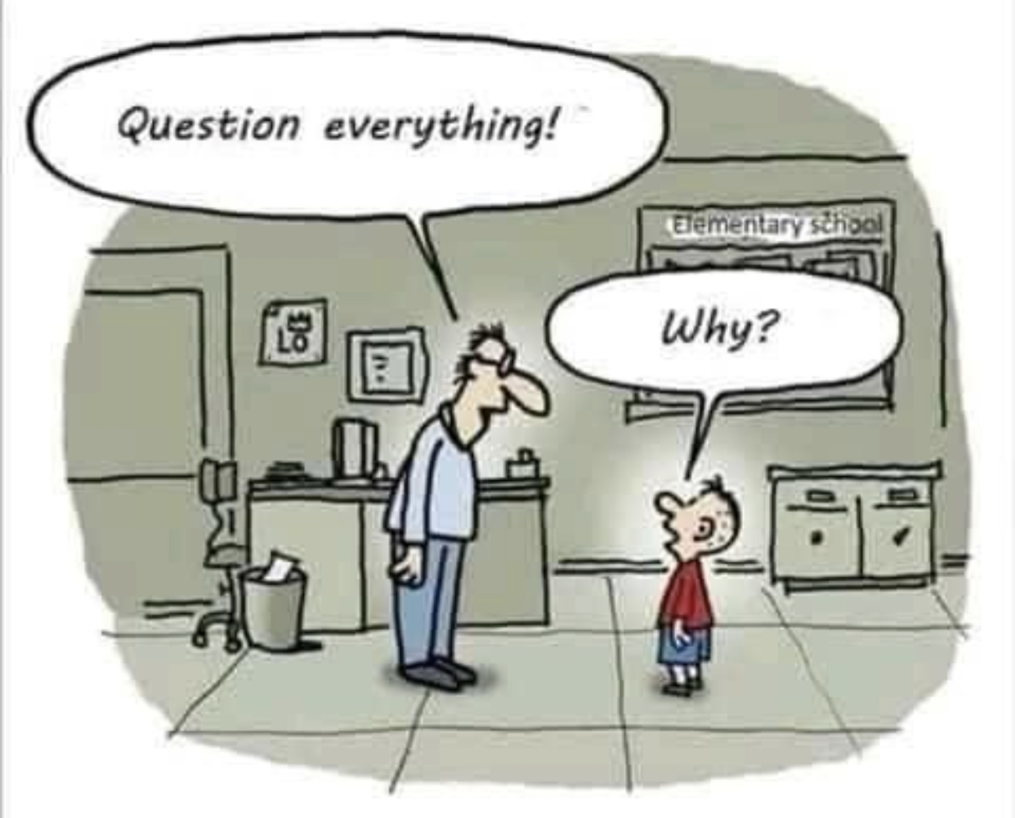
What does the first guy suggest?
Is it a Nash equilibrium? Why?
What does the second guy suggest?
What is his realization? Give an example of a game supporting his argument
Is that a Nash equilibrium? Why?
What questions do you have?

Slide 56
Exercise: Assurance game
 | Starbucks | Tvoje máma
Starbucks | (1,1) | (0,0)
Tvoje máma | (0,0) | (2,2)
Who are the players and their actions sets?
Does either player have a dominant strategy
Is there a pure strategy Nash aquilibrium? Is it unique?
Which equilibrium is more likely?

Slide 57
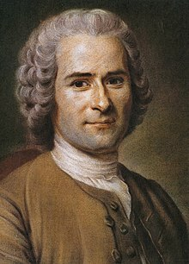
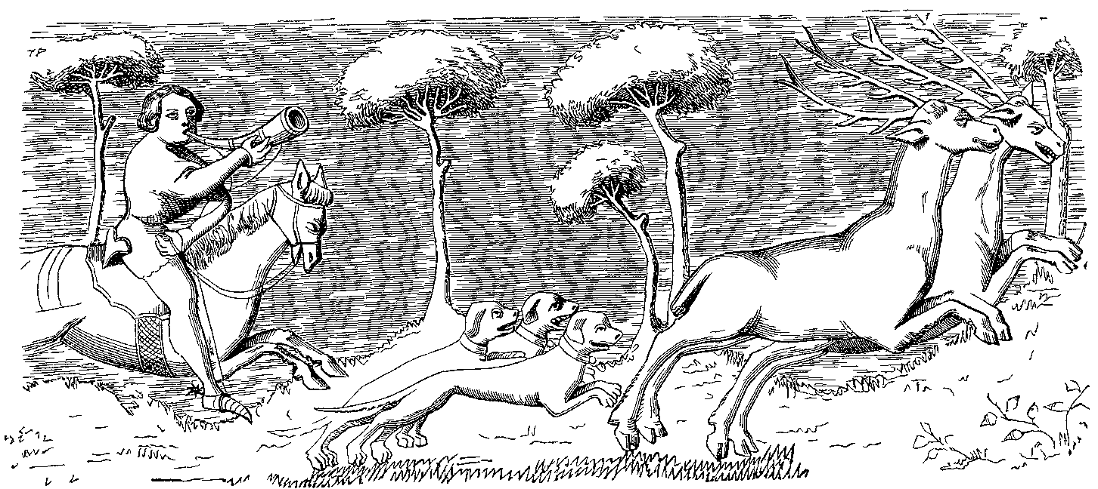
Exercise: Stag hunt
 | Stag | Hare
Stag | (10,10) | (1,8)
Hare | (8,1) | (5,5)
Who are the players and their actions sets?
Does either player have a dominant strategy
Is there a pure strategy Nash aquilibrium? Is it unique?
Which equilibrium is more likely?
How does this differ from prisoner’s dilemma?

Slide 58
Exercise: Battle of Cultures as a sequential game
Example: The Battle of Cultures
She: Finnish
He: Czech
 | Travel with friends | Travel w/o friends
Travel with friends | (2,1) | (0,0)
Travel w/o friends | (0,0) | (1,2)
Assume Matej’s wife gets to decide first (by booking her flight early)
Is this a simultaneous or a sequential game?
What will be the Nash equilibrium?

Slide 59
Exercise: Predator and prey
Prey
Predator
 | Active | Passive
Active | (2,-7) | (6,-8)
Passive | (3,-6) | (-1,0)
Who are the players and their actions sets?
Does either player have a dominant strategy
Is there a pure strategy Nash equilibrium? Is it unique?
Is there a mixed strategy Nash equilibrium?

Slide 60
Mixed-strategy Nash equilibrium in Predator and prey
Prey
Predator
 | Active | Passive
Active | (2,-7) | (6,-8)
Passive | (3,-6) | (-1,0)
Predator indifferent between being active or passive given prey‘s probability p of being active
Expected payoff if active = 2p + 6(1-p)
Expected payoff if passive = 3p - (1-p)
p = 7/8
Prey indifferent between being active or passive given predator‘s probability q of being active
Expected payoff if active = -7q – 6(1-q)
Expected payoff if passive = =8q
q = 6/7
So p=7/8 and q=6/7 is mixed strategy Nash equilibrium

